Slide 1

ParkSafe
Smart Vehicle Parking & Online Slot Booking Application
FIND. BOOK. PARK SAFE.
TEAM MEMBERS:
- Sayyed Mashhuda
- Sidat Ibrahim
- Patel Dhruvil
DEPARTMENT:
B.Voc (Bachelor of Vocation)
Software Development / Computer Applications

Slide 2
OVERVIEW
Introduction
ParkSafe is a smart parking application that helps people find and book parking spaces before they reach the parking location.
For Customers
• Find nearby parking locations easily.
• Check live available slots before arriving.
• Select Car, Bike, or EV parking.
• Choose custom date, time, and duration.
• Select exact floor and parking slot number.
• Receive a digital ticket with QR code instantly.
For Parking Admins
• Manage multiple parking locations.
• Configure multi-floor slot distribution.
• Scan customer QR codes for rapid check-in.
• Verify bookings and prevent location mismatch.
• Monitor real-time occupancy and daily revenue.
• Handle booking cancellations and refunds.

Slide 3
WORKFLOW
How ParkSafe Works
ParkSafe connects the customer, parking location, and admin in one unified digital system.
STEP 01
Search & Locate
Customer opens ParkSafe, selects city, and discovers nearby available parking locations in real time.
STEP 02
Select Slot
Chooses vehicle type (Car, Bike, EV), booking date, time duration, parking floor, and exact slot.
STEP 03
Book & Pay
Confirms reservation, completes fast payment via NETC FASTag or UPI, and gets instant digital ticket.
STEP 04
Scan & Park
Admin scans customer QR code at the gate for rapid check-in validation, parking, and smooth check-out.

Slide 4
KEY BENEFITS
Advantages of ParkSafe
Saves Time & Fuel
Customers book in advance and drive directly to their assigned slot without searching.
Real-Time Slot Visibility
Shows live available slots per floor and category (Car, Bike, and EV spots).
Multi-Floor Management
Organizes large parking complexes into easy-to-navigate floor and slot numbers.
Contactless QR Entry
Admin scans digital QR code for instant check-in and check-out at the gate.
Integrated Navigation
One-tap Google Maps directions directly guide drivers to the parking gate.
Complete Admin Control
Admins manage locations, slots, live check-ins, revenue trends, and refunds.

Slide 5
COMPARISON
Before and After ParkSafe
Before ParkSafe (Traditional Parking)
✕ Drivers search for parking spots manually on the road.
✕ No information about slot availability before arriving.
✕ Long wait times and manual paper ticket entry at gates.
✕ Multi-floor parking is confusing and difficult to navigate.
✕ Admins track vehicles and collections using manual registers.
✕ No proper mechanism for digital cancellations or refunds.
With ParkSafe (Smart Parking)
✓ Drivers search and book parking online in advance.
✓ Live slot availability visible per floor and vehicle type.
✓ Fast QR code scan for contactless check-in and check-out.
✓ Pre-allocated floor and slot numbers guide drivers clearly.
✓ Admin Panel manages live occupancy, slots, and revenue.
✓ Automated digital booking tickets and refund processing.

Slide 6
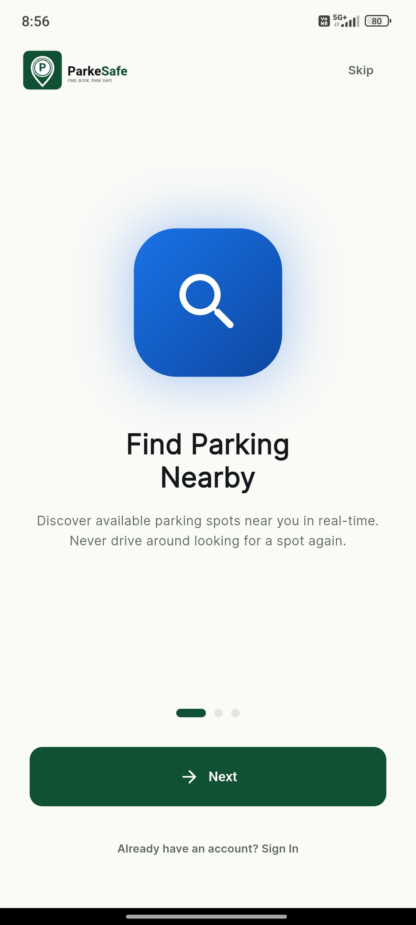
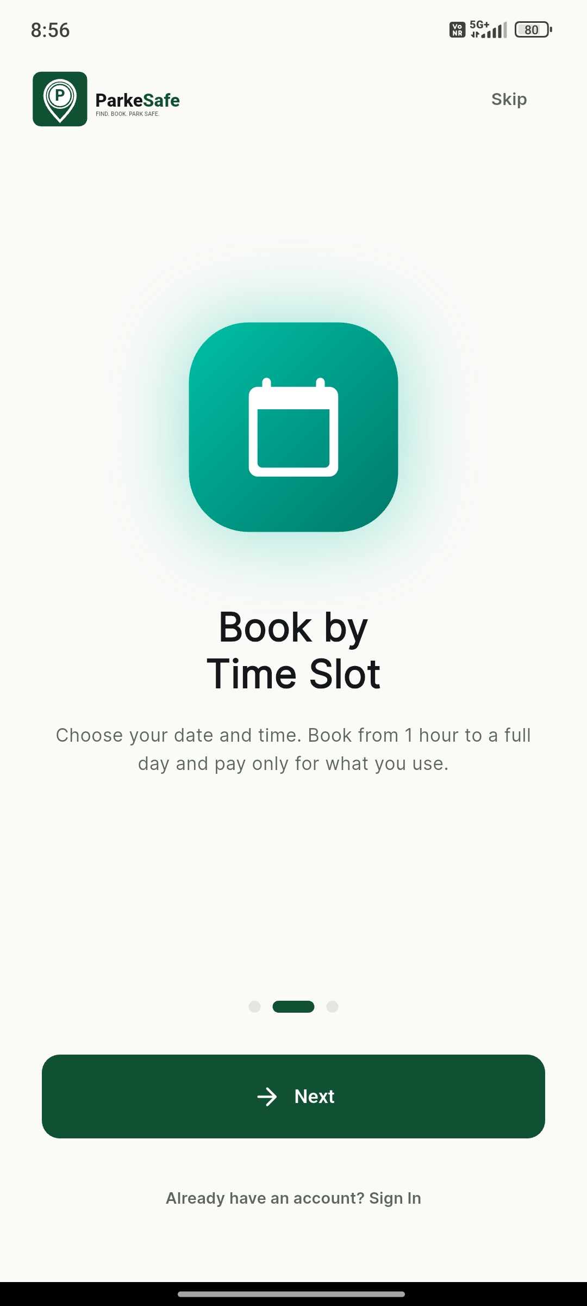
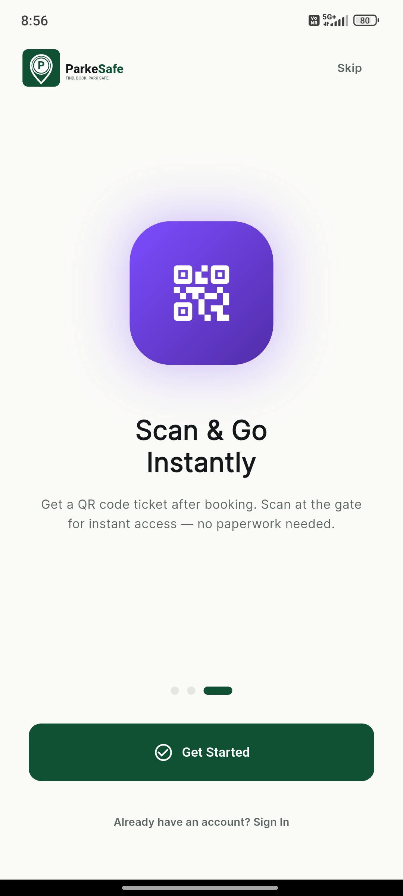
APPLICATION FLOW
Onboarding Screens
Interactive onboarding screens introducing users to nearby search, slot booking, and QR tickets.

Slide 7
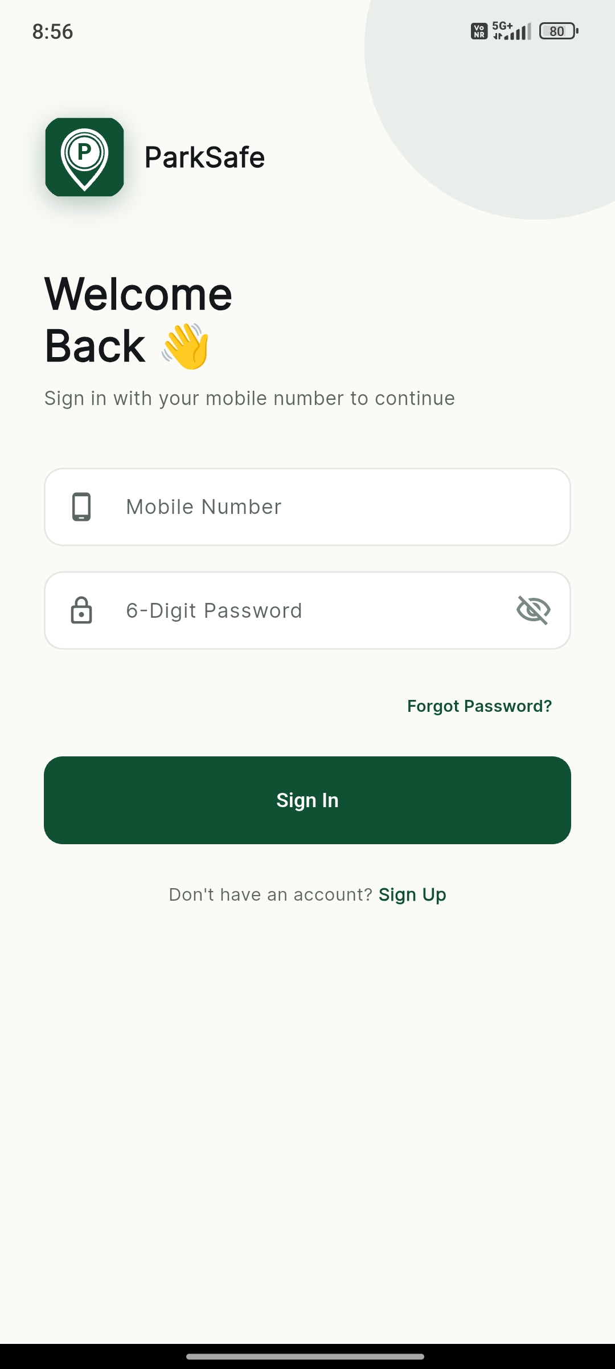
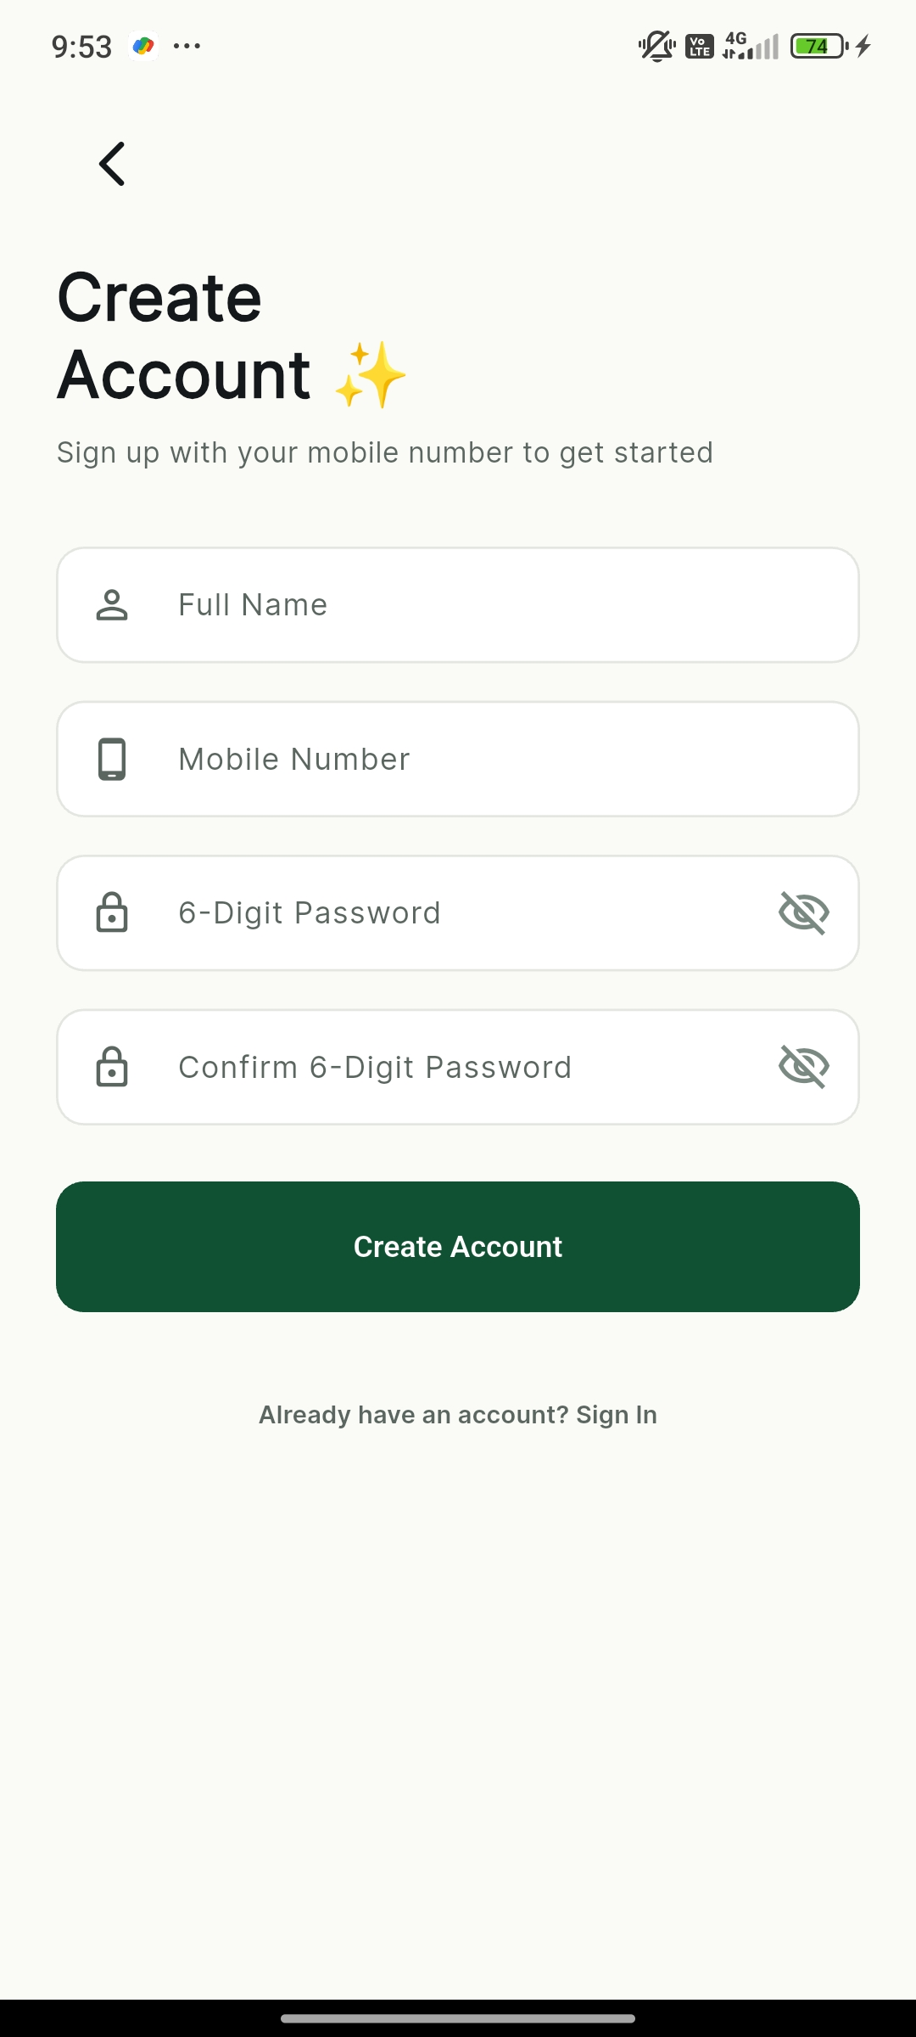
AUTHENTICATION
Login and Registration
Secure mobile authentication supporting user registration and returning user sign-in.

Slide 8
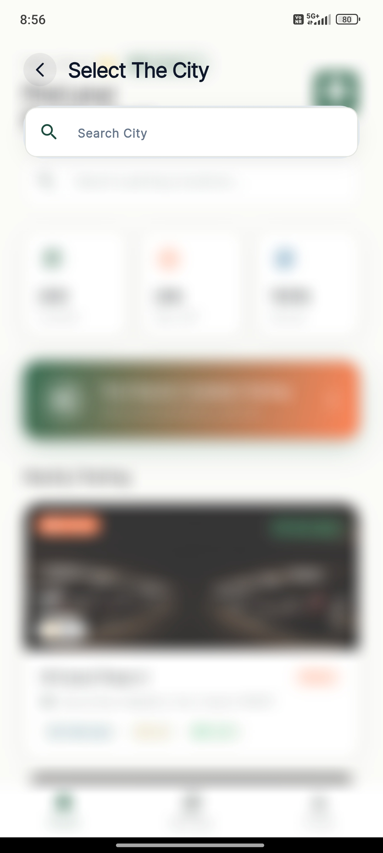
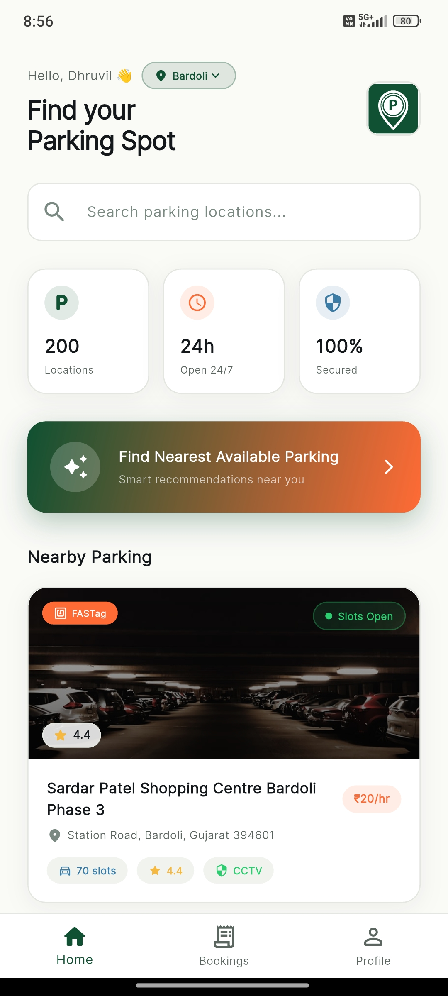
CUSTOMER INTERFACE
City Selection and Customer Home
Select preferred city and explore available parking locations with live search and statistics.

Slide 9
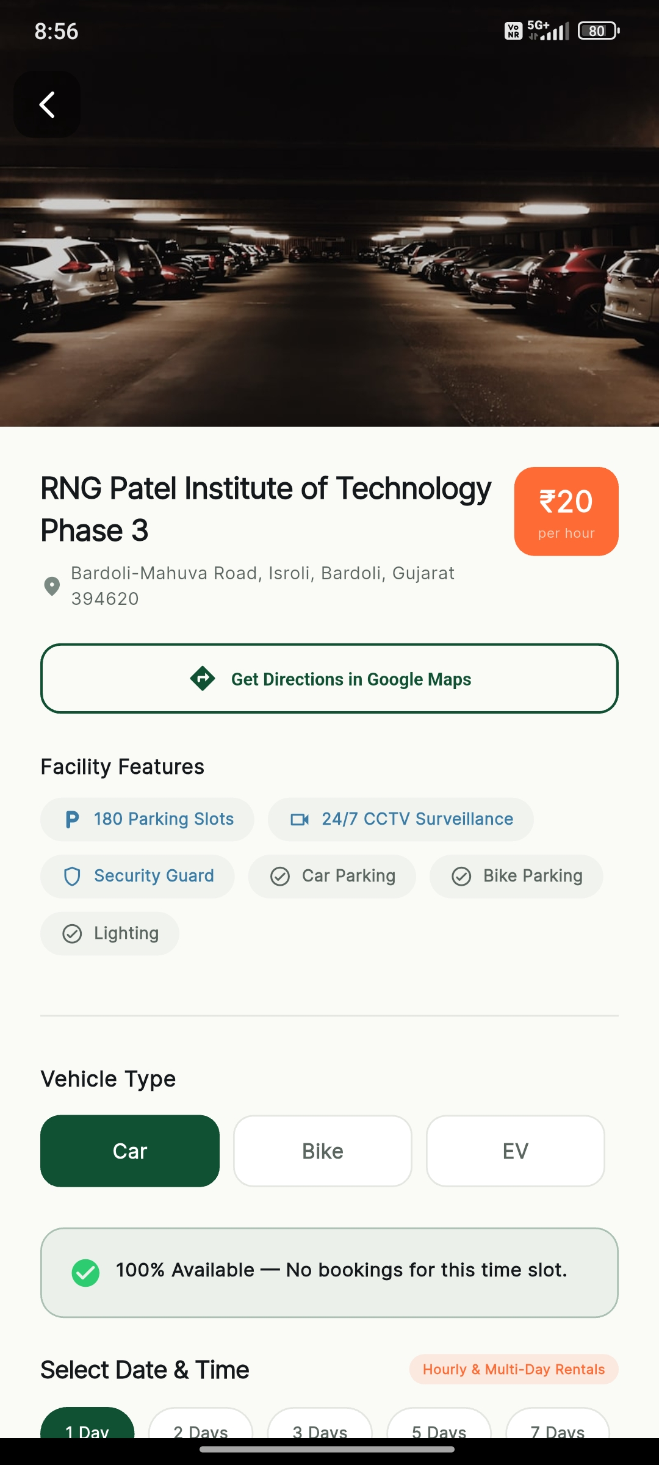
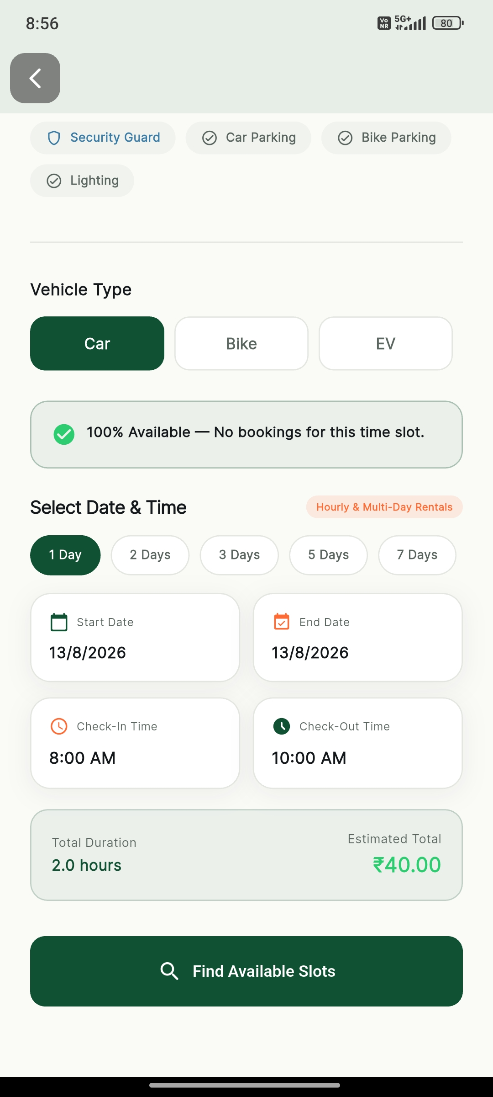
BOOKING PROCESS
Parking Details and Vehicle Selection
View location amenities, hourly pricing, Google Maps navigation, and vehicle type selection.

Slide 10
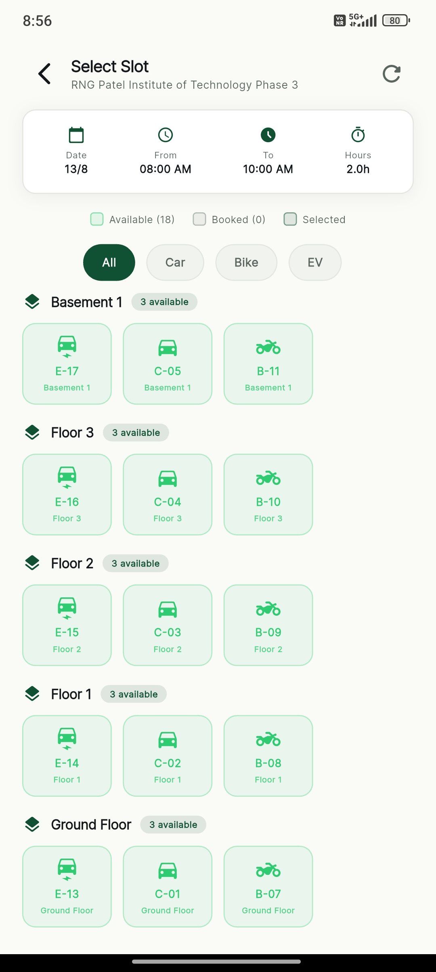
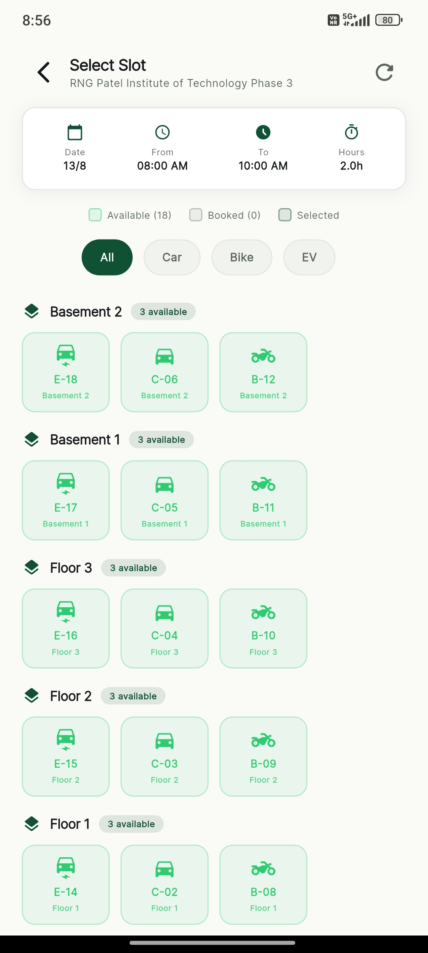
SLOT ALLOCATION
Floor-Wise Slot Selection
Browse different floors (Basement 1, Basement 2, Ground Floor) and select an available parking slot.

Slide 11
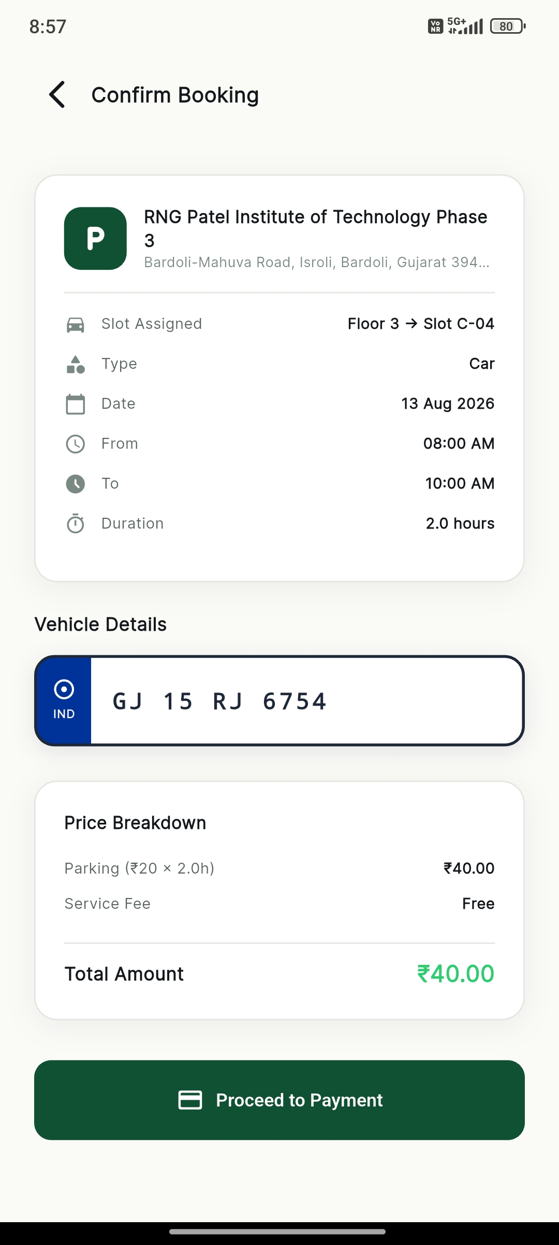
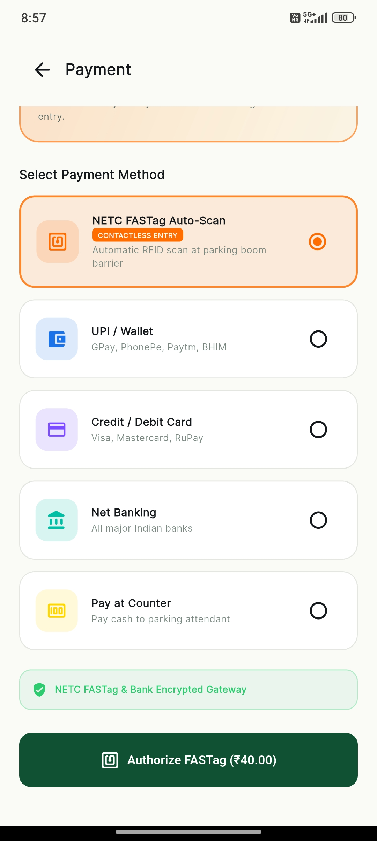
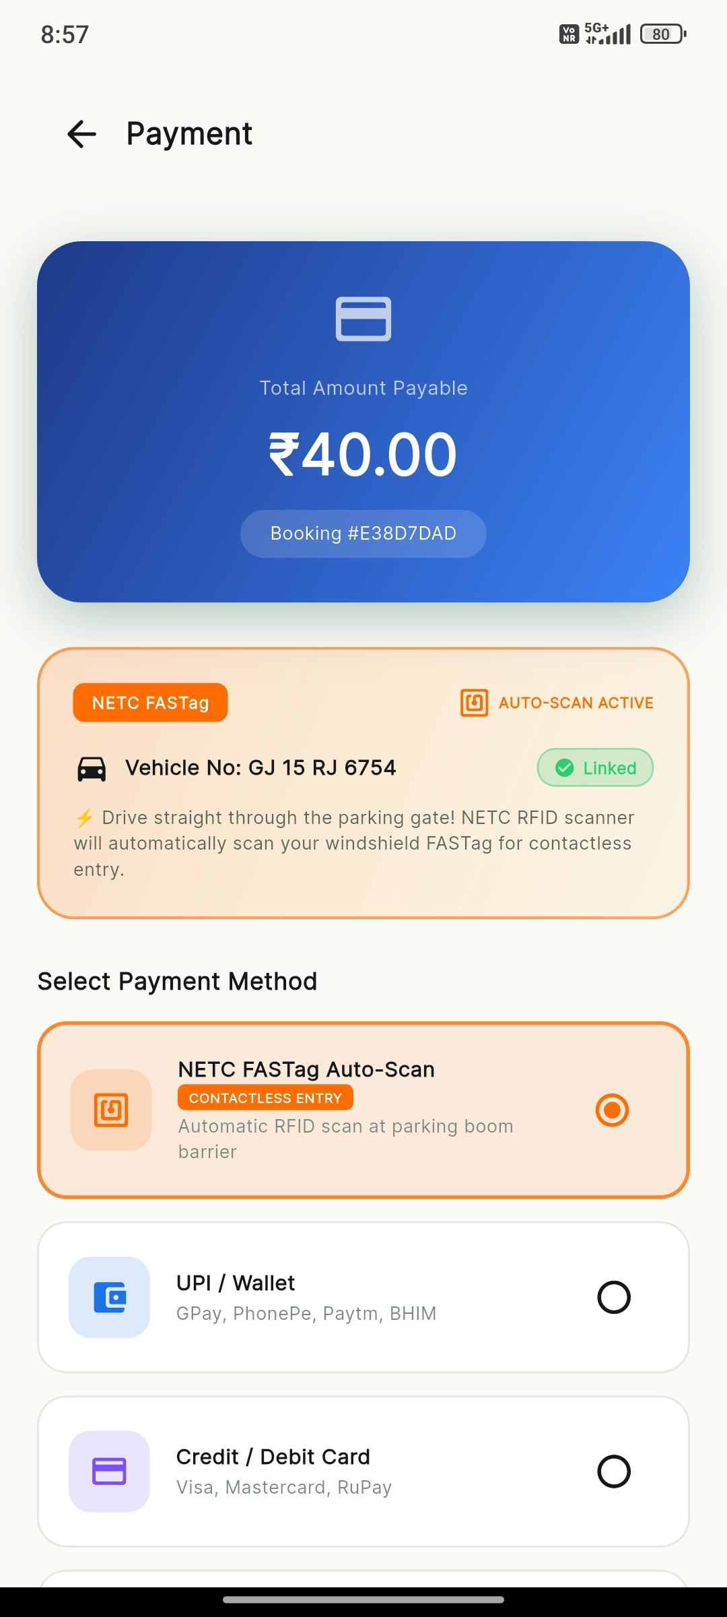
CHECKOUT FLOW
Booking Confirmation and Payment
Review reserved slot timing and choose payment via NETC FASTag Auto-Scan or UPI / Wallet.

Slide 12
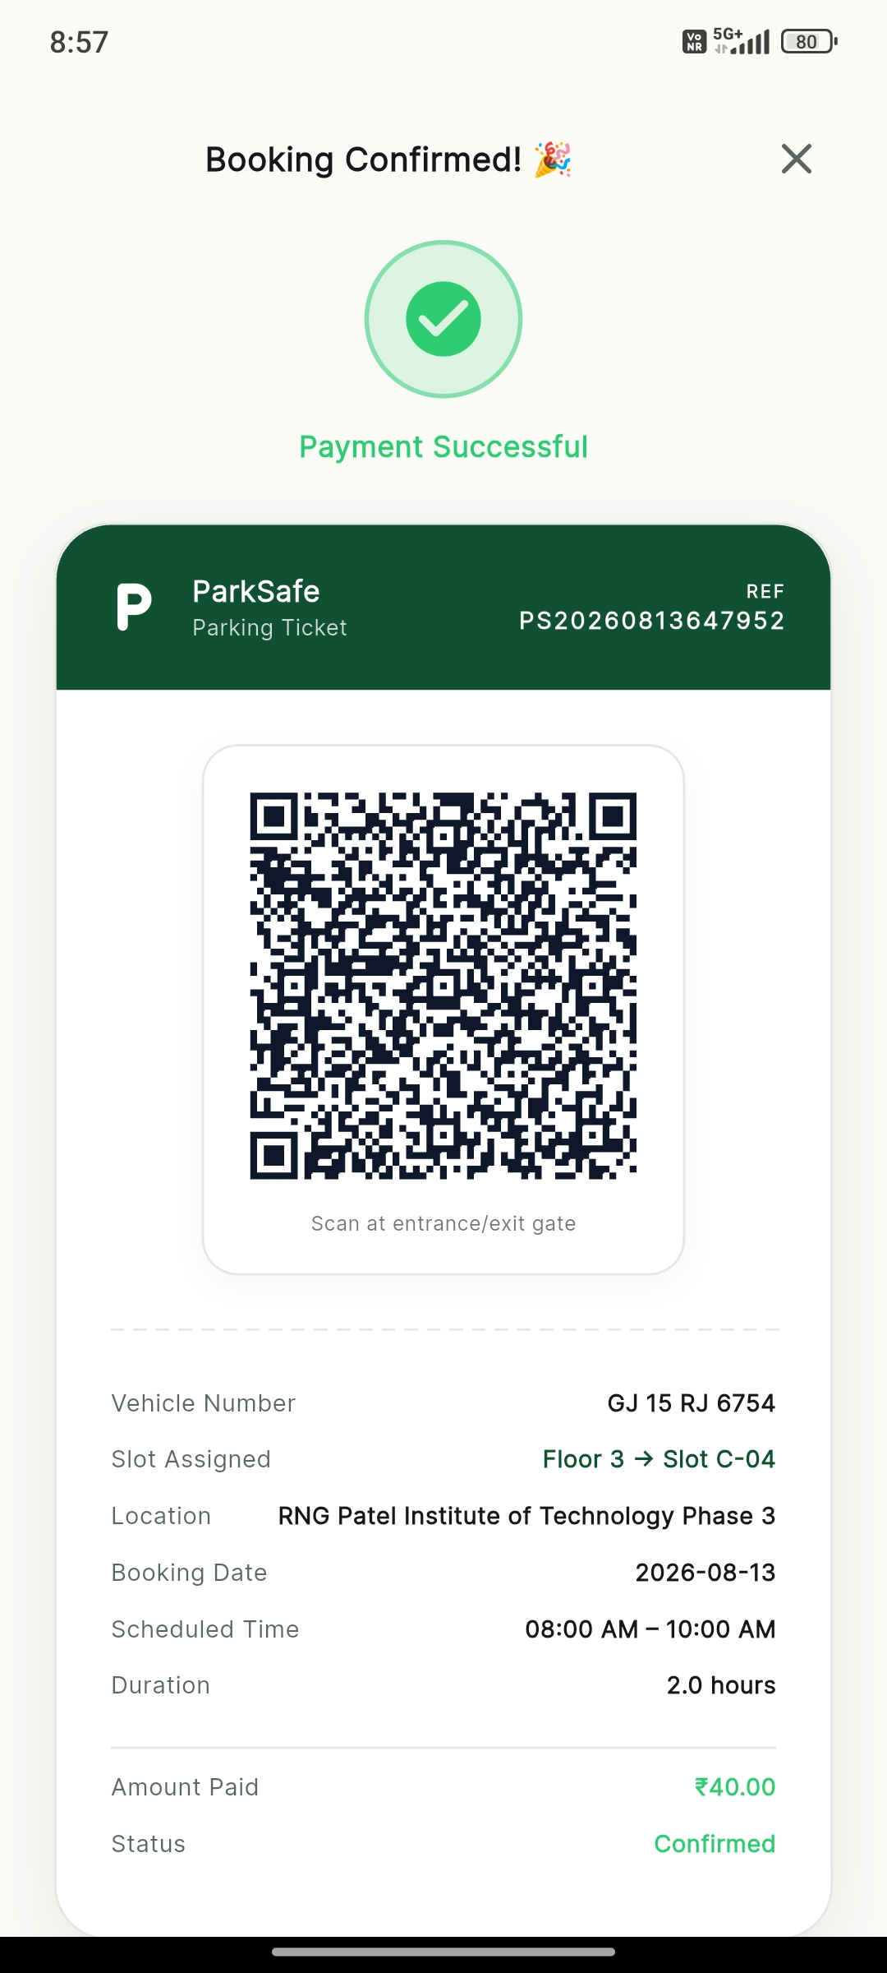
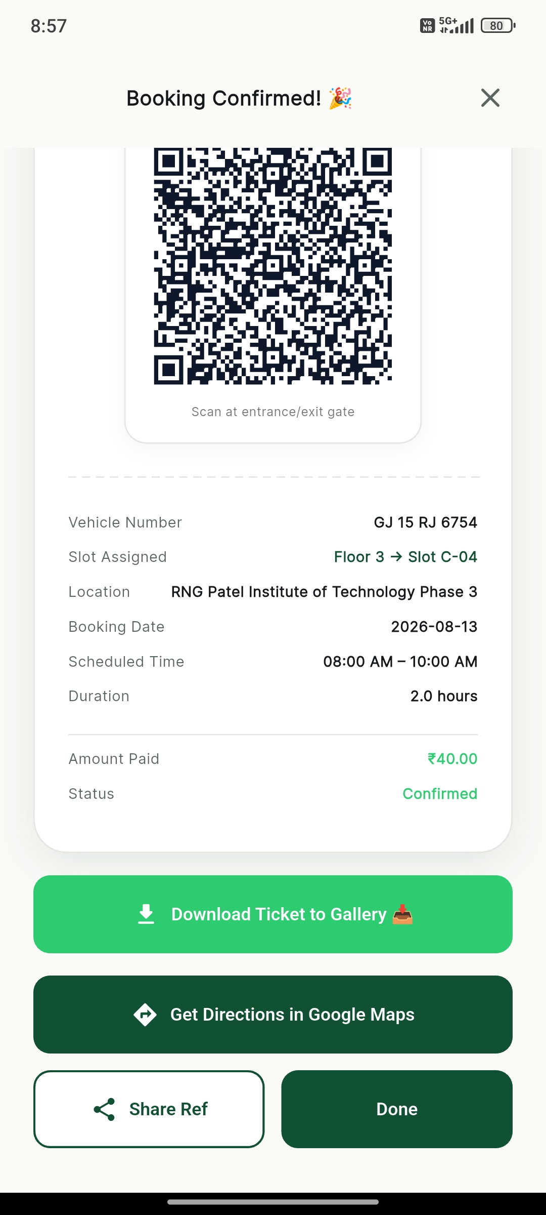
DIGITAL TICKET
Digital Booking Ticket & QR Code
Instant booking confirmation generating a digital QR pass containing slot and vehicle details.

Slide 13
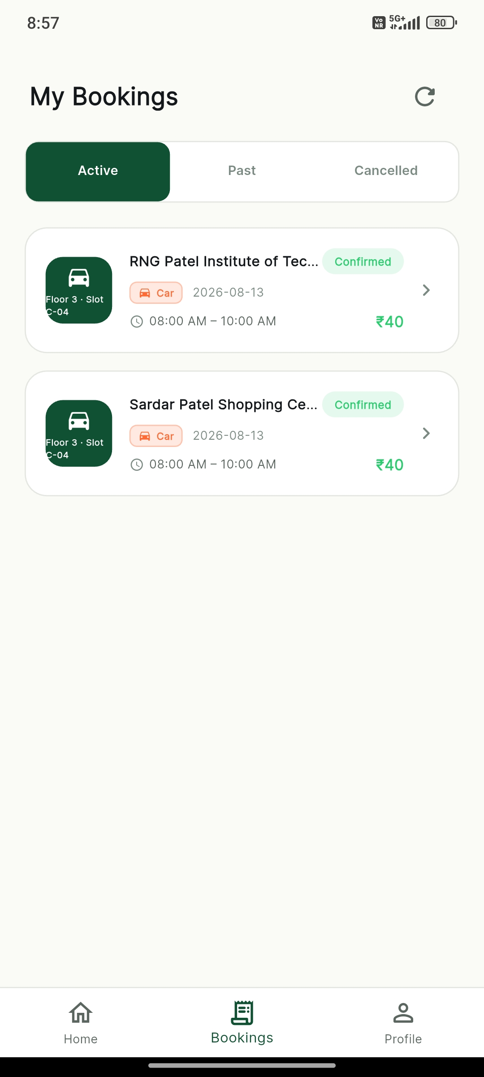
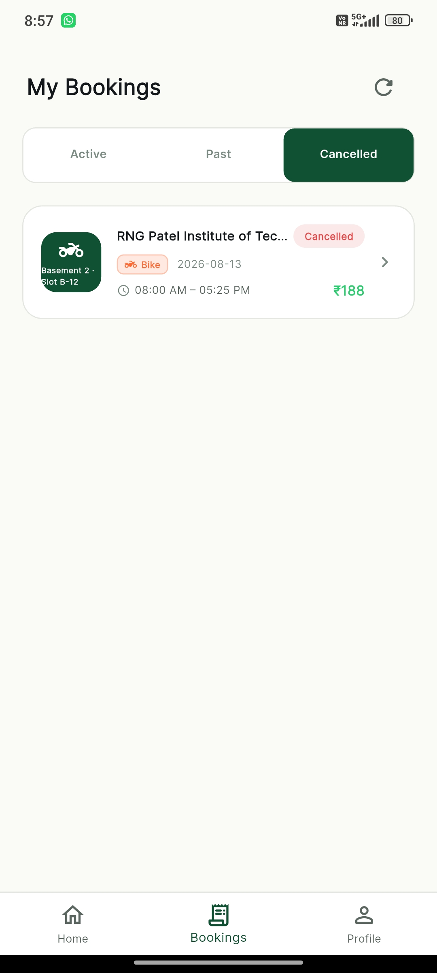
BOOKING MANAGEMENT
My Bookings (Active and Past)
Customers can track their active parking sessions and access past booking history.

Slide 14
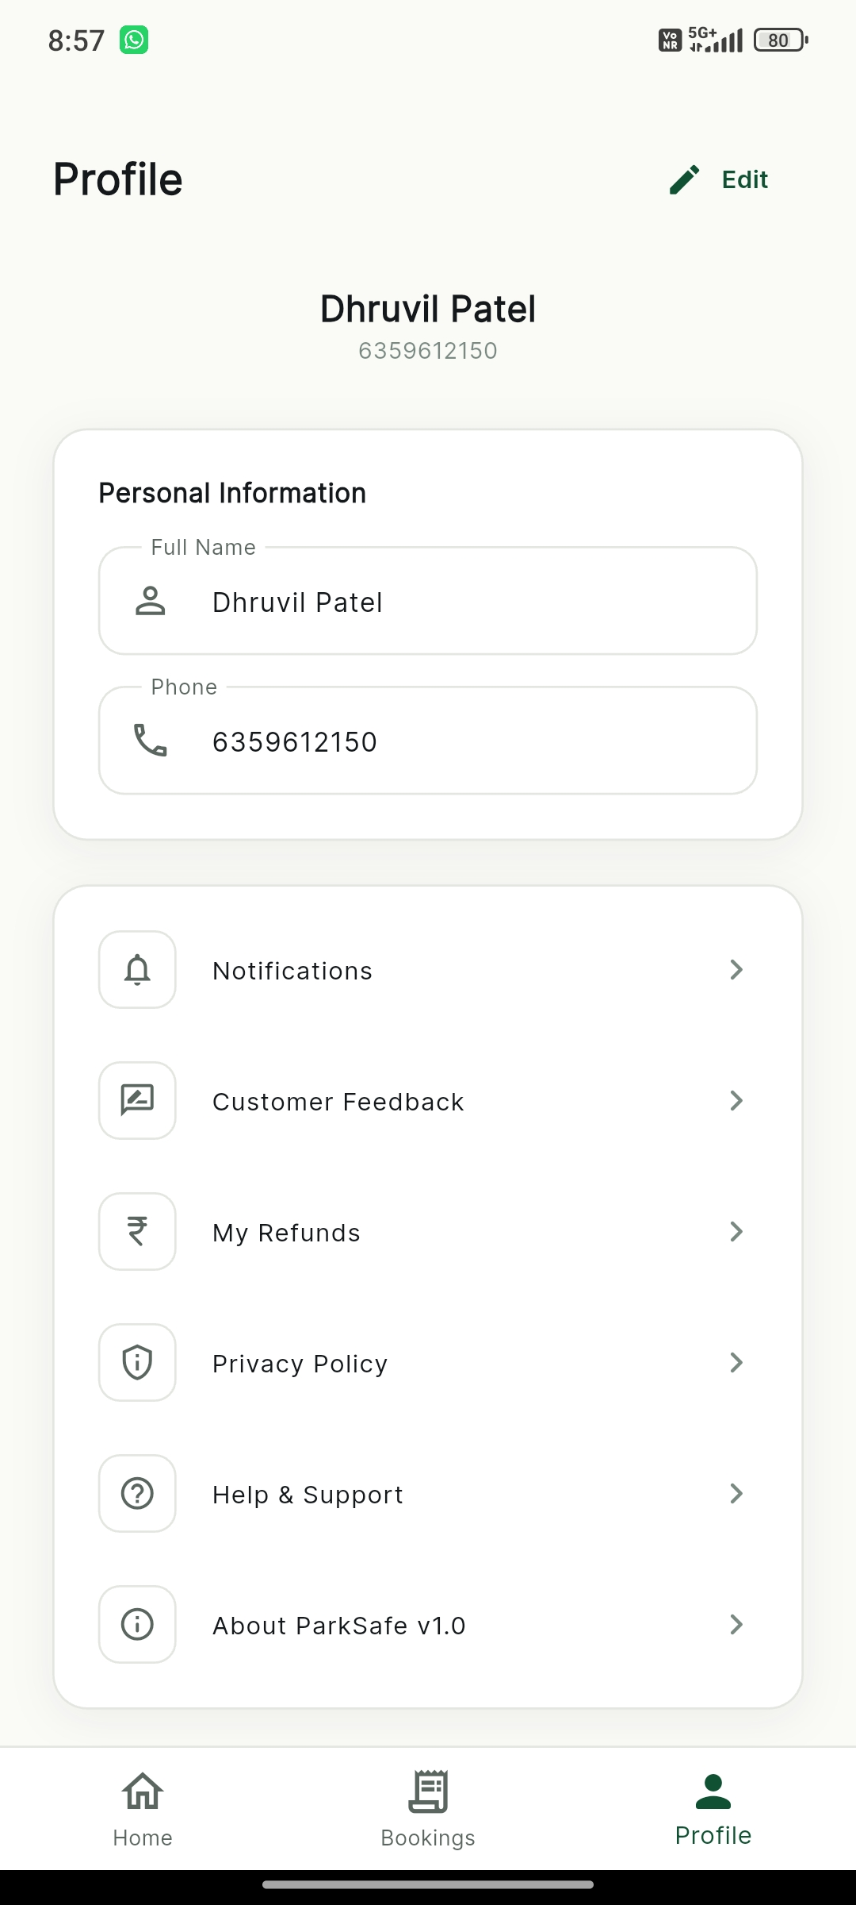
ACCOUNT SETTINGS
Customer Profile
Customers manage their personal information, saved vehicles, and account preferences.

Slide 15
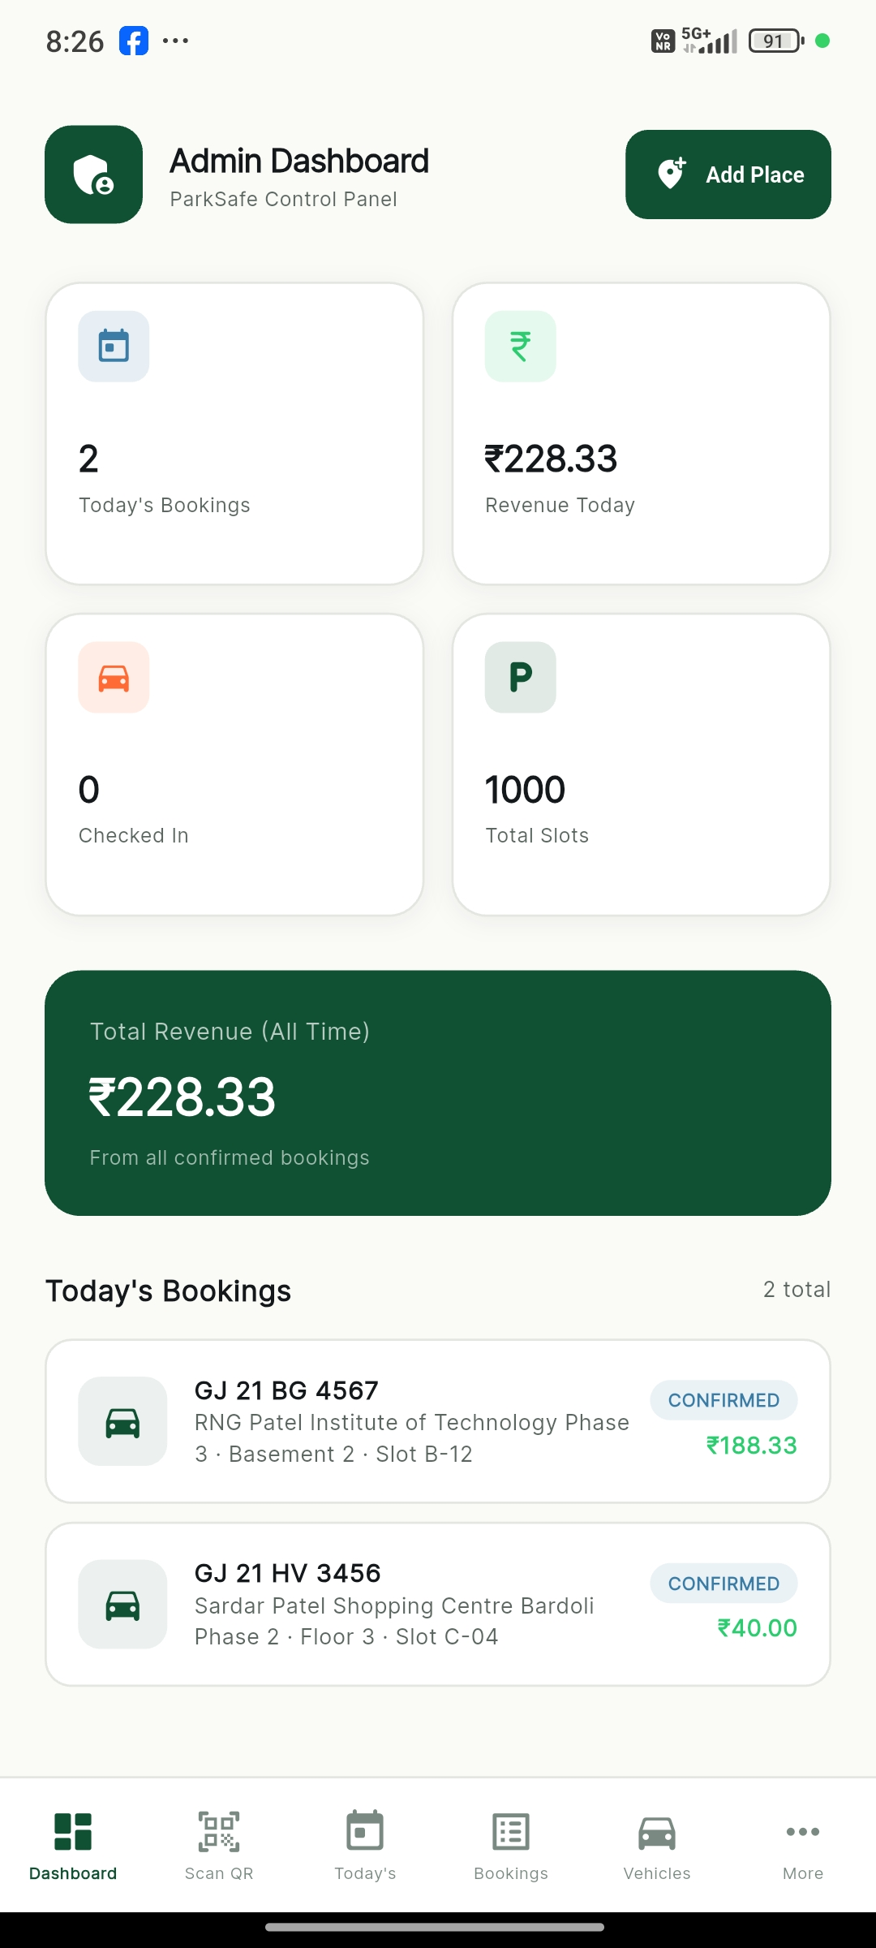
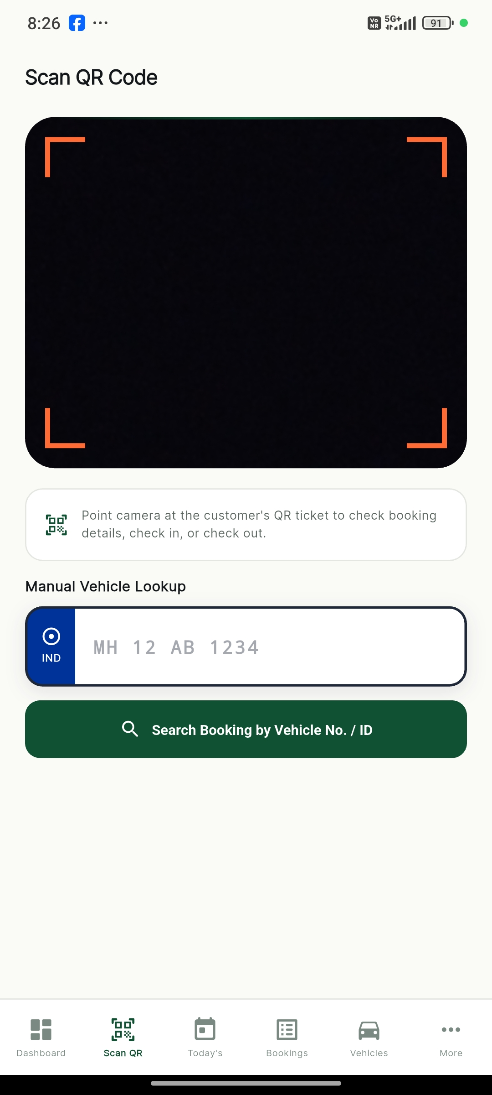
ADMIN OPERATIONS
Admin Dashboard and QR Scanner
Live occupancy and revenue dashboard paired with camera QR scanner for instant check-in.

Slide 16
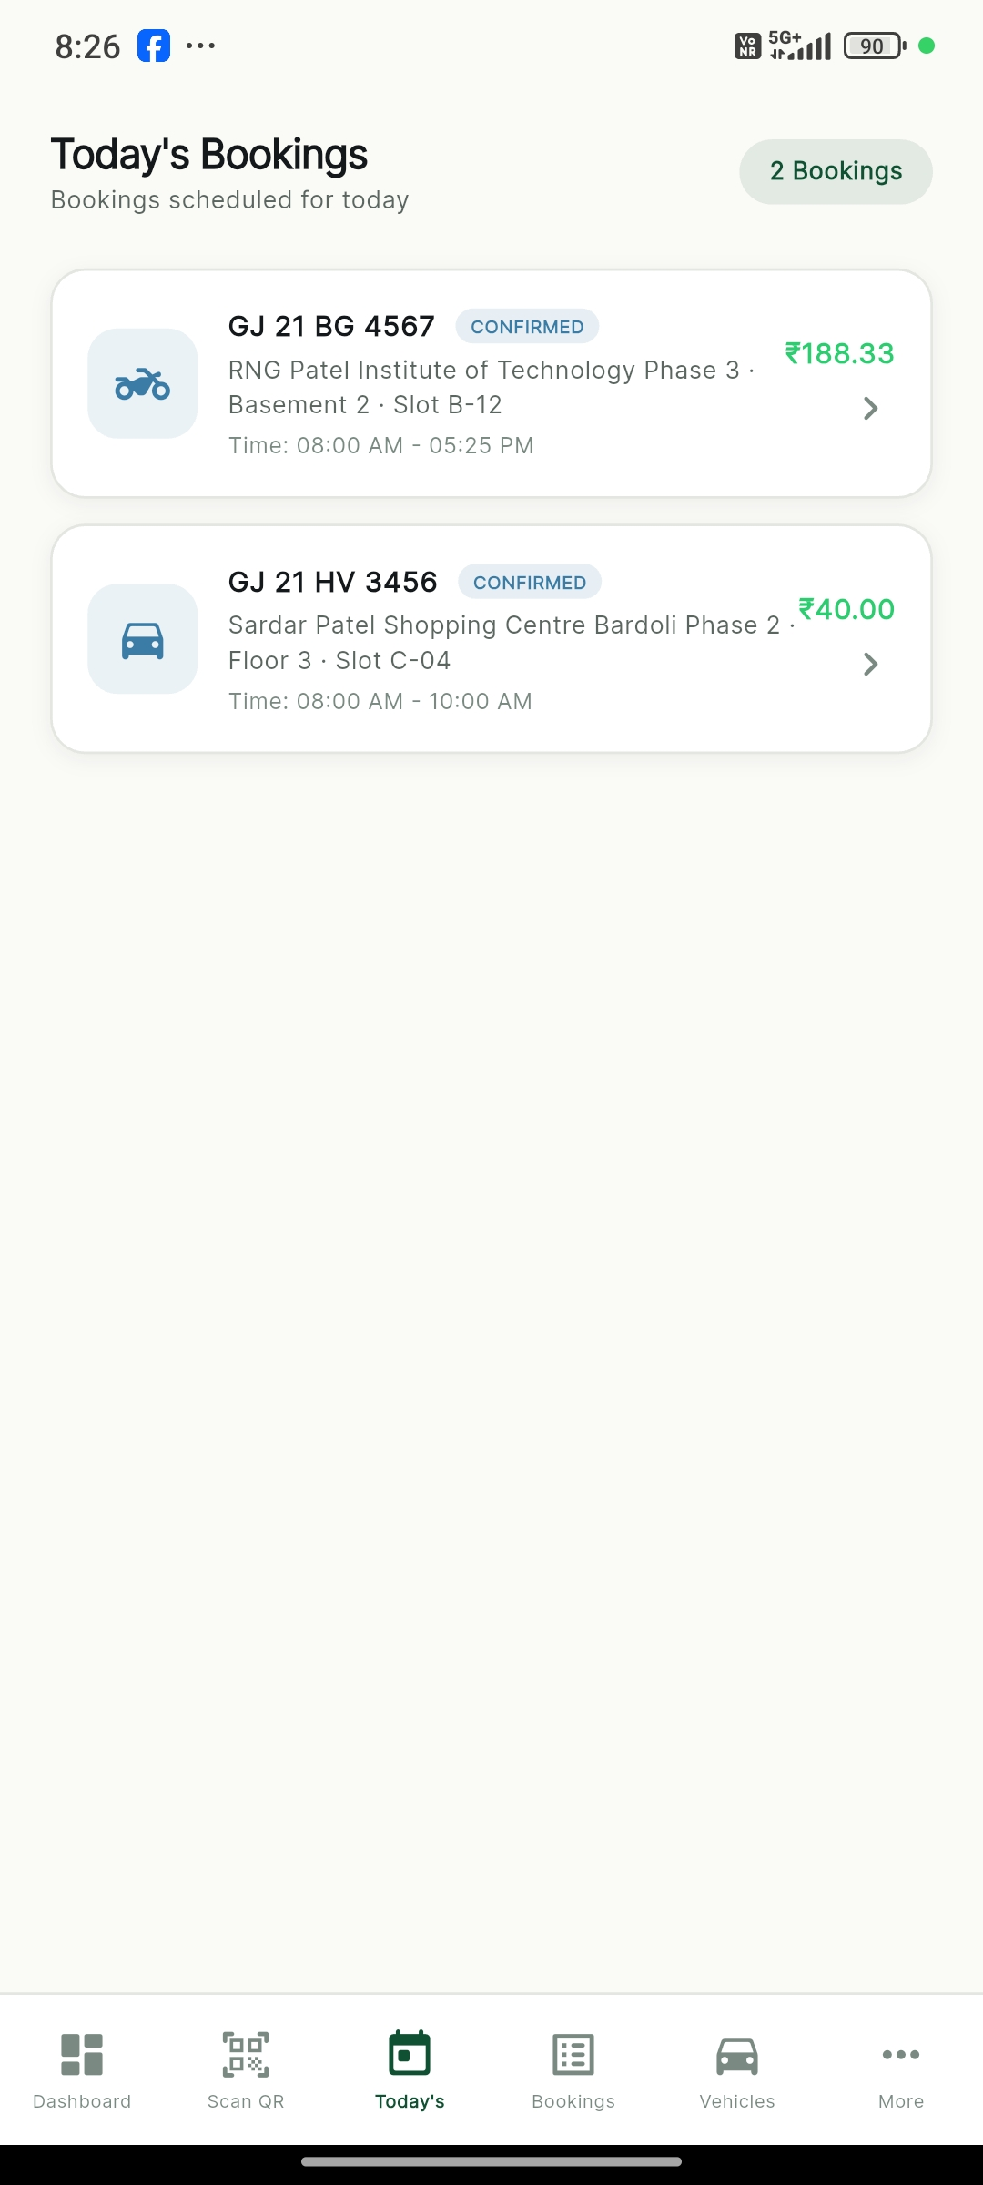
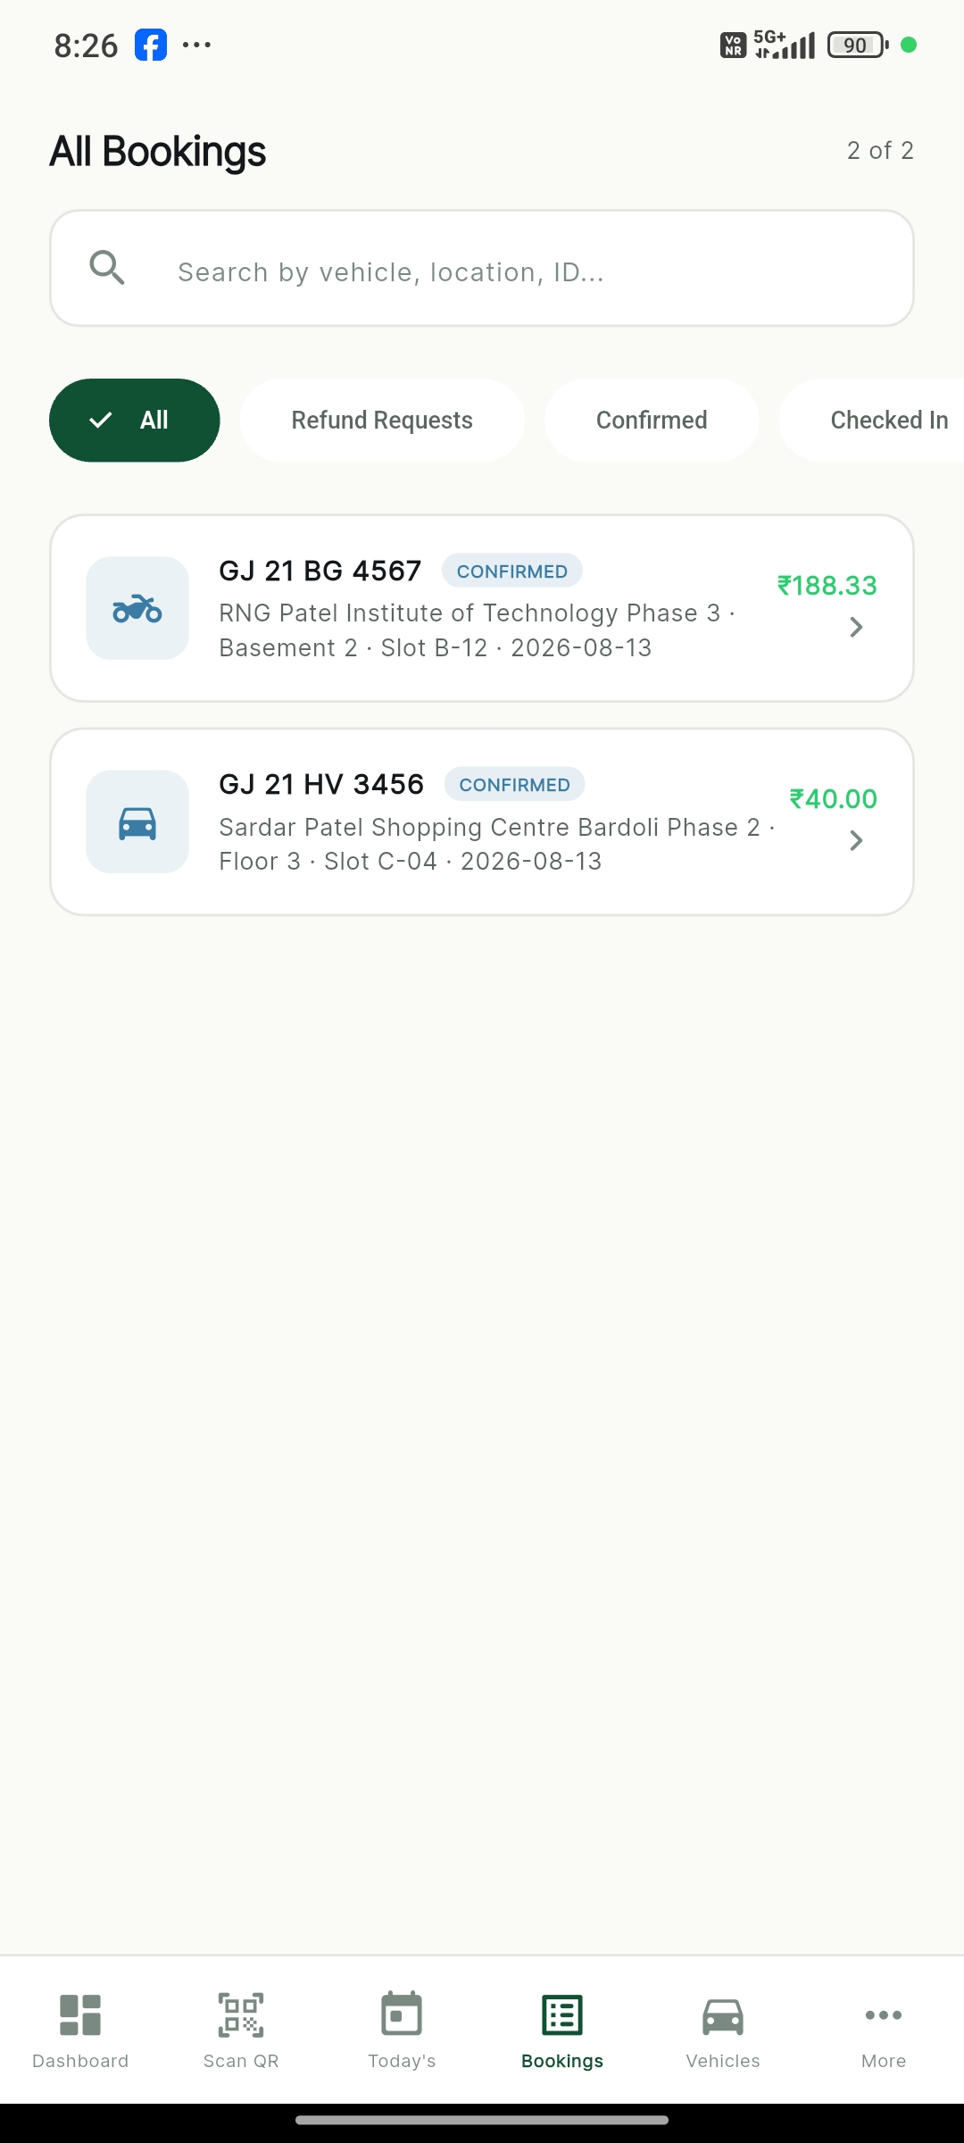
ADMIN OPERATIONS
Admin Booking Management
Real-time monitoring of today's scheduled arrivals and comprehensive all-bookings records.

Slide 17
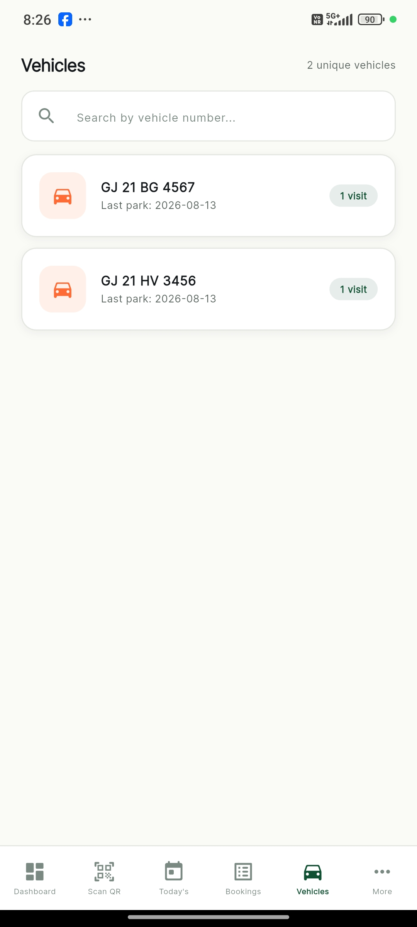
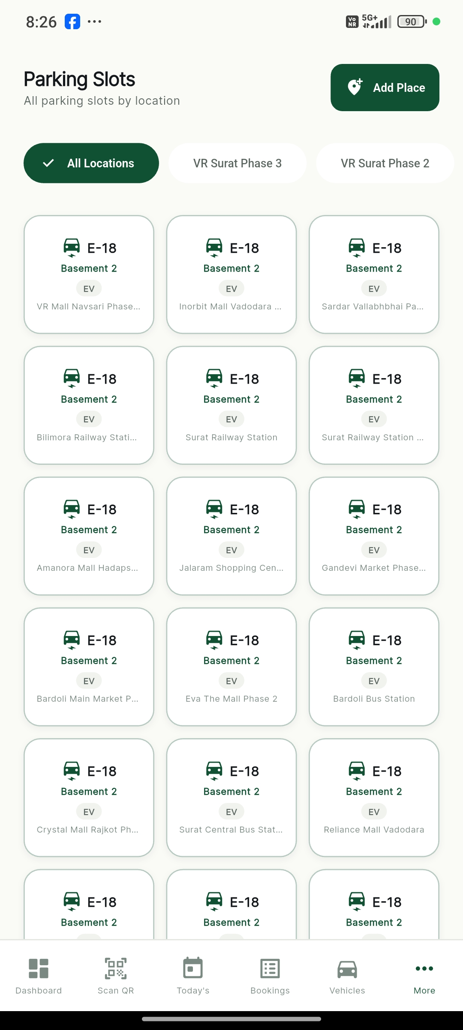
ADMIN OPERATIONS
Vehicles and Slot Management
Detailed parked vehicle logs and multi-floor slot distribution (Car, Bike, and EV spots).

Slide 18
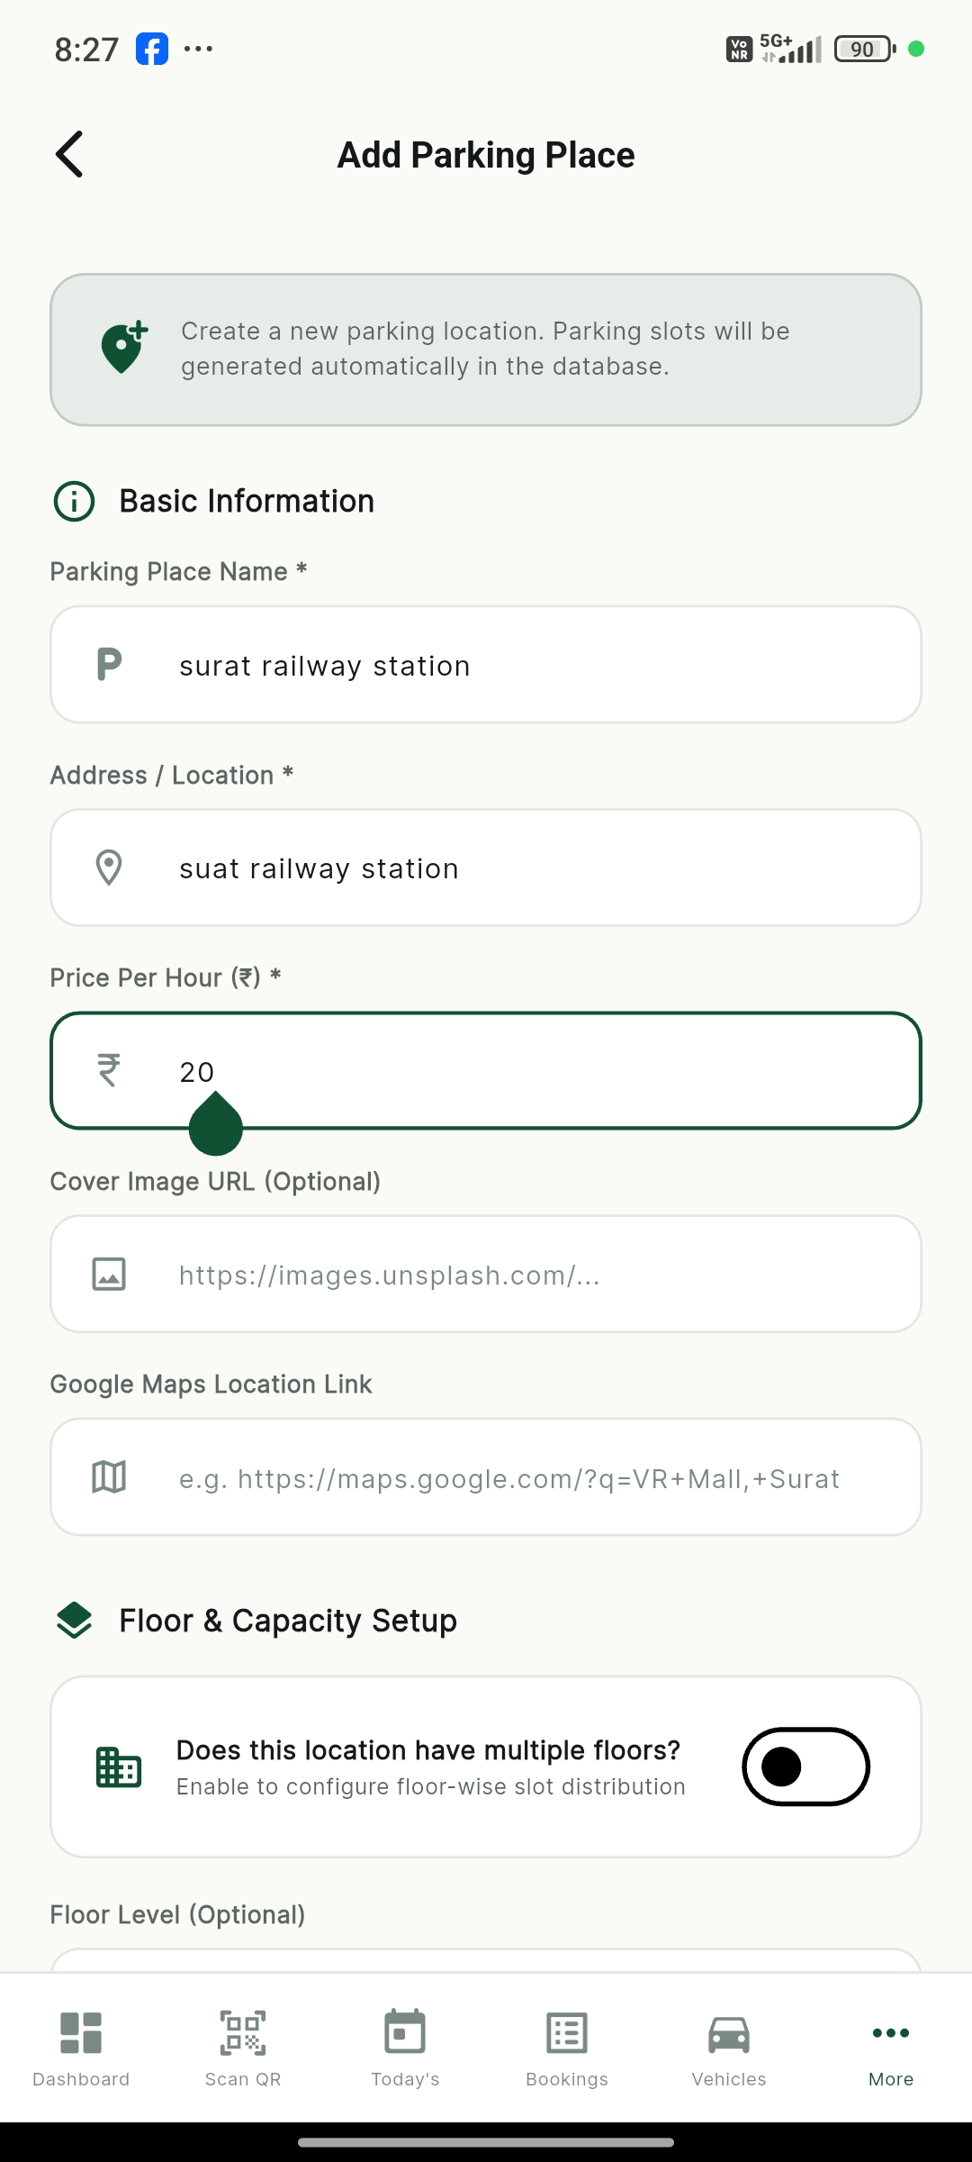
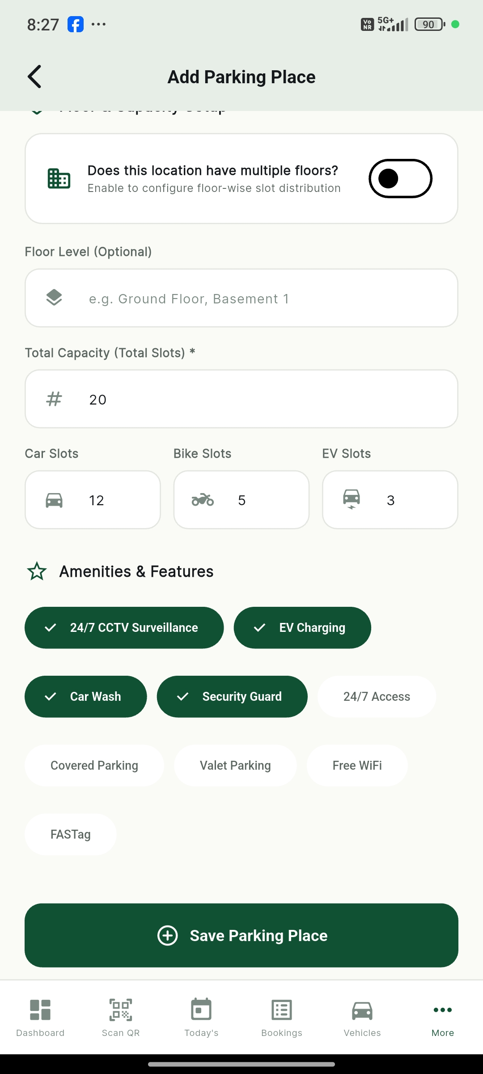
ADMIN OPERATIONS
Parking Location and Floor Configuration
Admins can add new parking locations and configure multi-floor slot distribution.

Slide 19
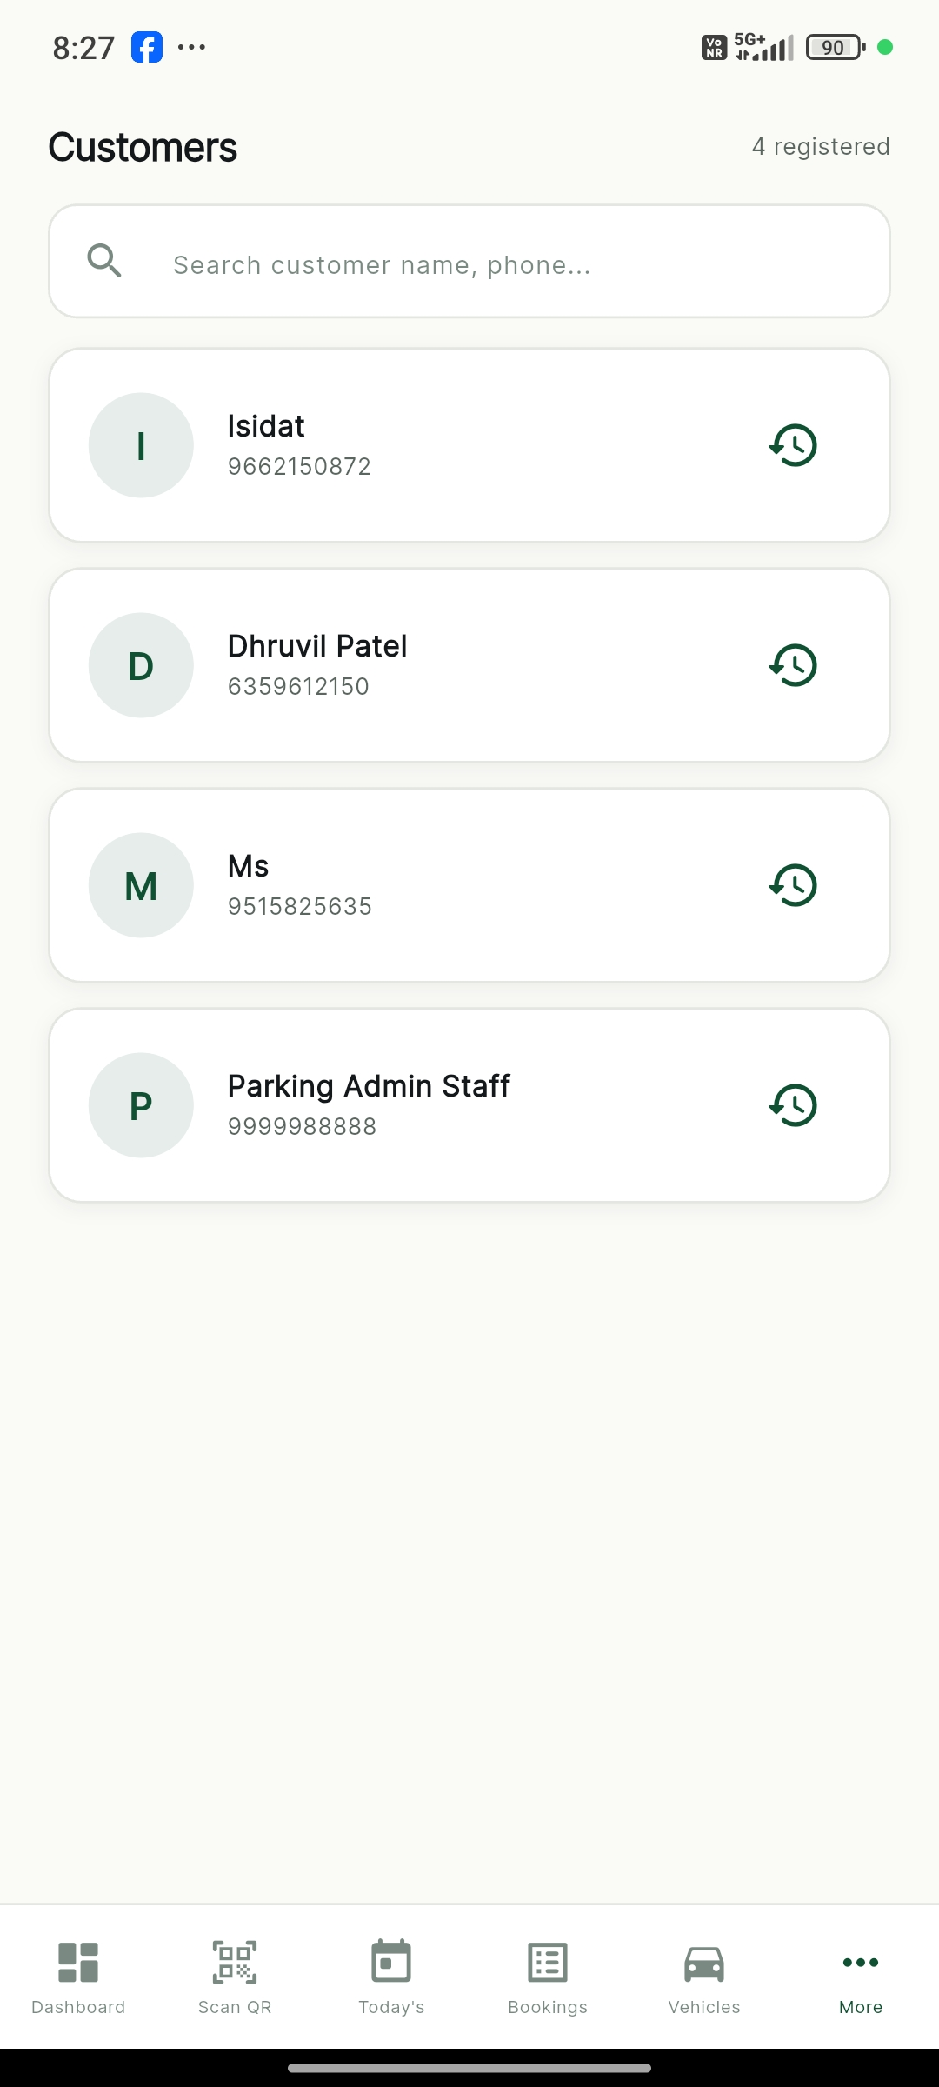
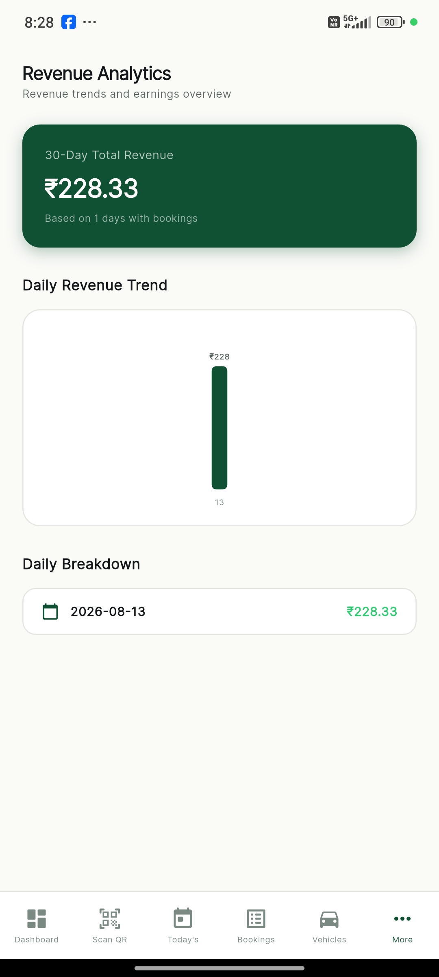
ADMIN OPERATIONS
Customer List and Revenue Analytics
Directory of registered users and visual 30-day parking revenue trend analytics.

Slide 20
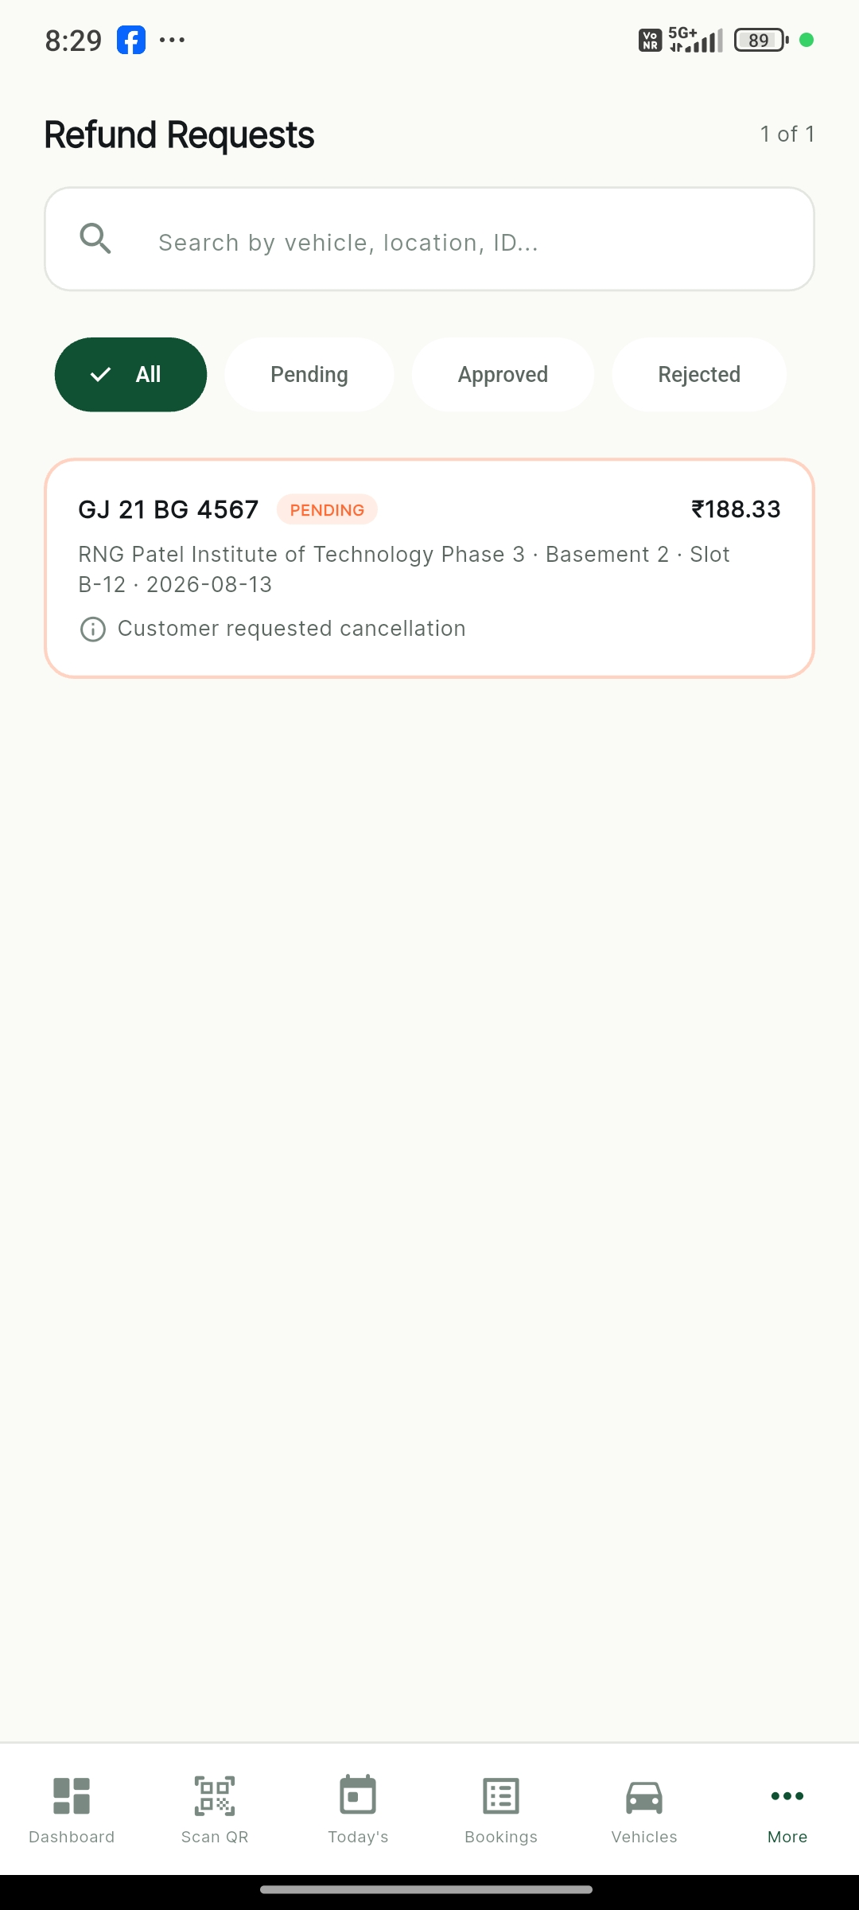
ADMIN OPERATIONS
Refund Management
Admins review customer cancellation refund requests and approve or reject them directly.

Slide 21
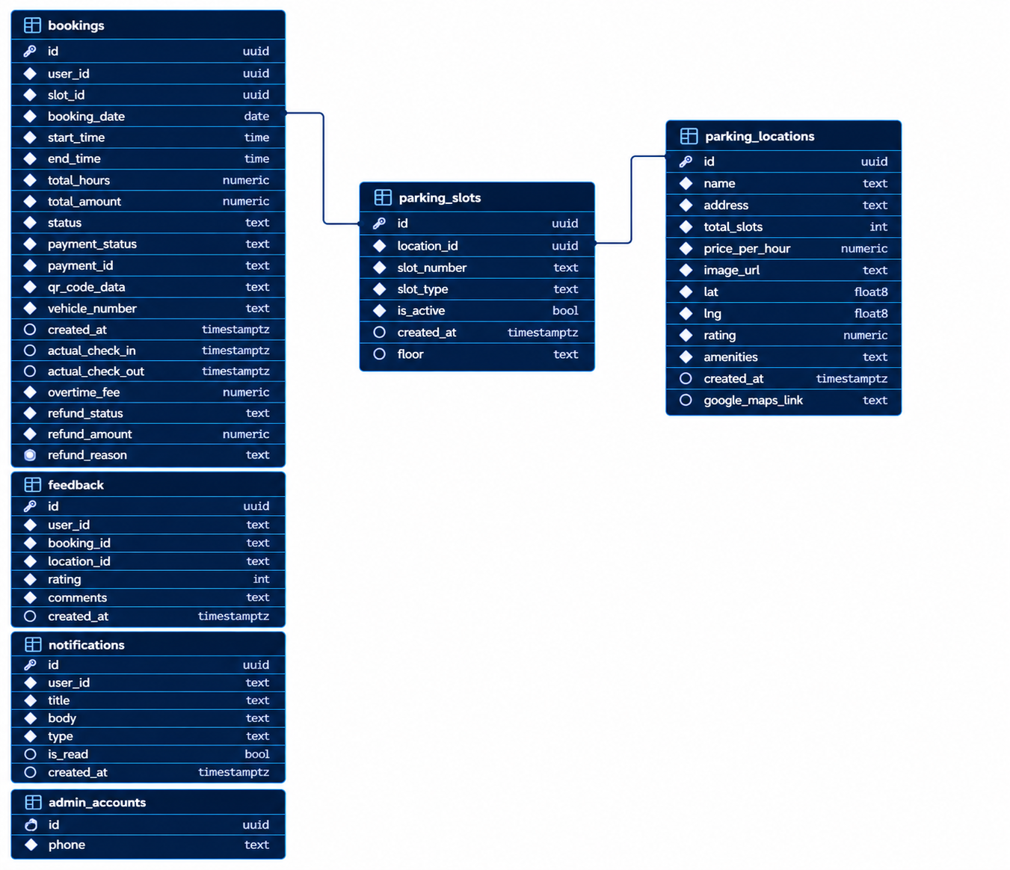
BACKEND & DATABASE
Database Schema & Entity Architecture
Relational architecture in Supabase PostgreSQL: profiles, admin_accounts, parking_locations, slots, bookings, and feedback.

Slide 22
PROJECT TECHNOLOGIES
References & Technology Stack
Flutter & Dart
Cross-platform mobile and web application framework delivering high performance and responsive UI.
Supabase & PostgreSQL
Scalable cloud database backend, real-time data synchronization, and row-level security.
Provider State Management
Clean and reactive state management architecture connecting UI components to backend services.
GoRouter Navigation
Declarative and structured deep-linking routing for seamless multi-screen navigation flow.
Mobile Scanner & QR Engine
High-speed camera barcode/QR scanner integration for instant gate check-in and check-out.
Geolocator & Google Maps
Real-time location detection and GPS route navigation directing users to parking locations.

Slide 23
Thank You
ParkSafe — Smart Vehicle Parking & Online Slot Booking Application
FIND. BOOK. PARK SAFE.
TEAM MEMBERS:
- Sayyed Mashhuda
- Sidat Ibrahim
- Patel Dhruvil
DEPARTMENT:
B.Voc (Bachelor of Vocation)
Software Development / Computer Applications

